Slide 1
Class 1 AI Saturdays Abuja
Linear Algebra, Calculus and Statistics

Slide 2
Class Format
Theoretical class and discussions
A quiz in the middle of the class
Demonstrations.

Slide 3
Why Mathematics?
It is the language of machine learning and deep learning.
It would give you good intuition into models.
It helps if you want to build your own algorithms.
It helps provide very deep understanding of algorithms.

Slide 4
Parts of Mathematics Required?
All parts of mathematics. But especially
Linear Algebra
Calculus
Statistics
Probability

Slide 5
Linear Algebra

Slide 6

What is linear Algebra?
Linear algebra is a sub-field of mathematics concerned with linear equations and their representations through matrices and vectors.

Slide 7
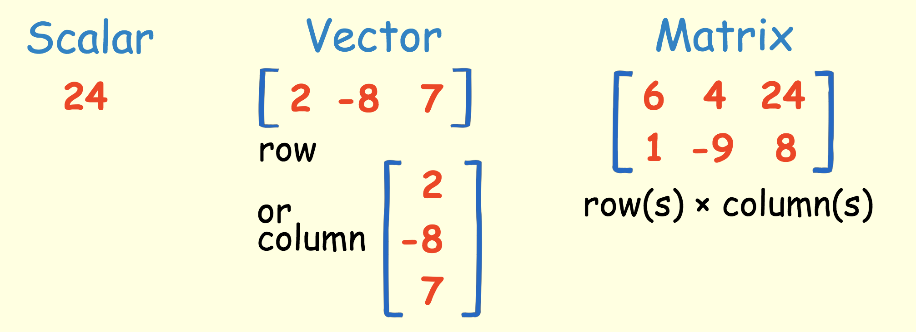
Scalars, vectors and matrices
A scalar is simply a single number. For example 24.
A Vector is an ordered array of numbers and can be in a row or a column.
A Matrix is an ordered 2D array of numbers and it has two indices.

Slide 8
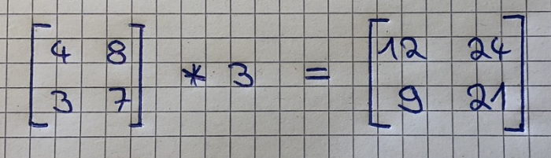
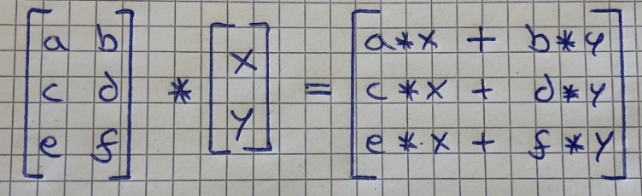
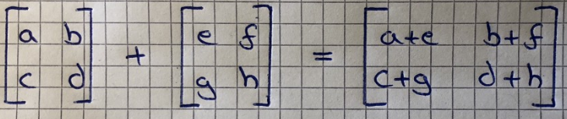
Computational Rules
Matrix-Scalar Operations :
Matrix-Vector Multiplication :
Matrix-Matrix Addition and : Subtraction

Slide 9
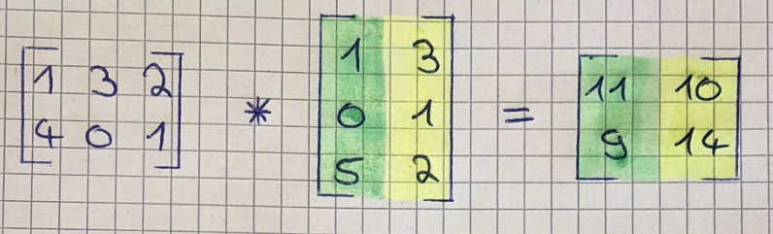
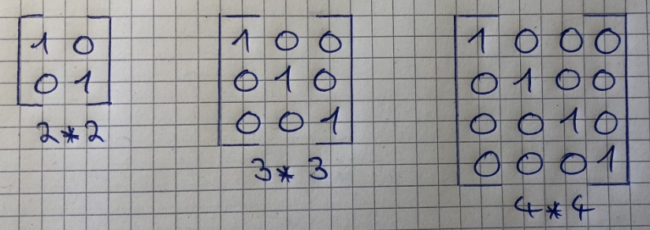
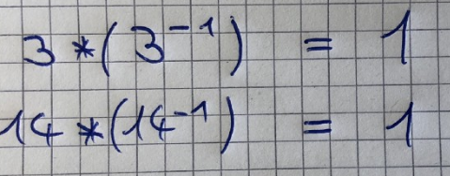
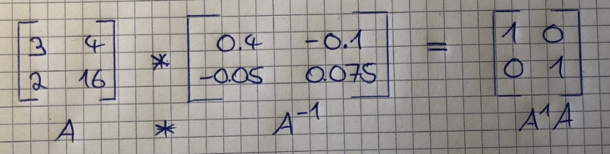
Computational Rules (contd.)
Matrix-Matrix Multiplication:
Others
Identity Matrix :
Inverse Matrix :

Slide 10
Computational Rules (contd.)
Matrix-Matrix Multiplication:
Others
Identity Matrix :

Slide 11
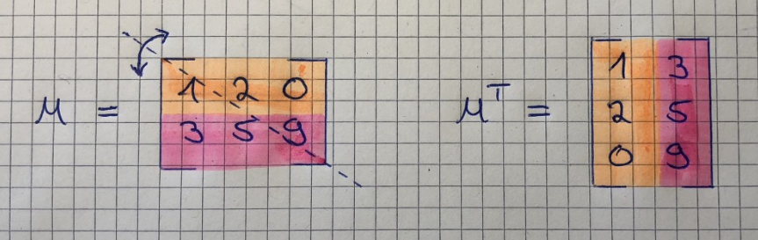
Computational Rules (contd.)
Inverse Matrix :
Matrix Transpose :

Slide 12
Calculus

Slide 13
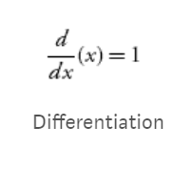
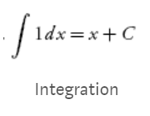
What is calculus?
Calculus is the branch of mathematics studying the rate of change of quantities. Calculus is divided into differential and integral calculus.

Slide 14




Differential Rules
Rule 1: The differential of a constant is zero
Rule 2: The power rule
Rule 3: Derivative of a function multiplied by a constant
Rule 4: sum or difference rule

Slide 15
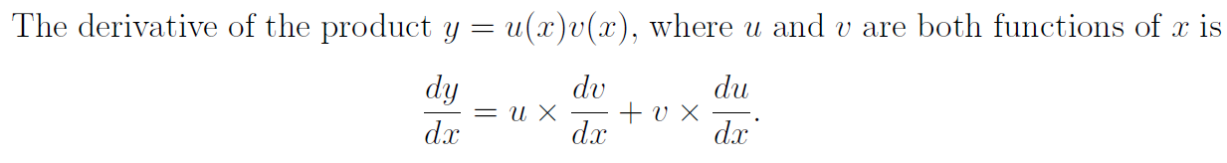
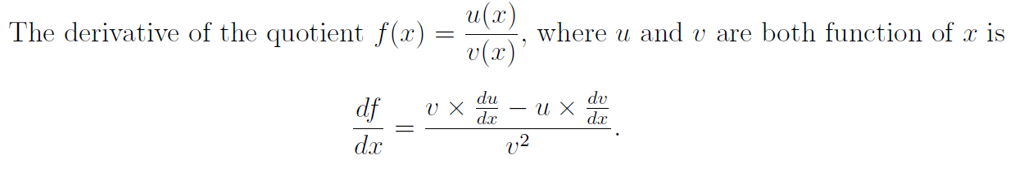
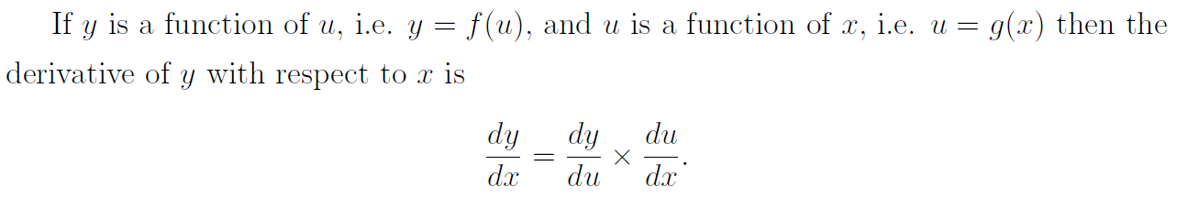
Differential Rules (contd.)
Rule 5: The product rule.
Rule 6: The Quotient rule
Rule 7: The Chain rule

Slide 16
Common Uses of Differentiation
Used for calculating maximum and minimum of a function (this application is utilized in a very common)
Used for calculating the slope of curves
These two applications are used in a very popular optimization algorithm called gradient descent. This algorithm is used all around machine and deep learning.

Slide 17
Probability and Statistics

Slide 18
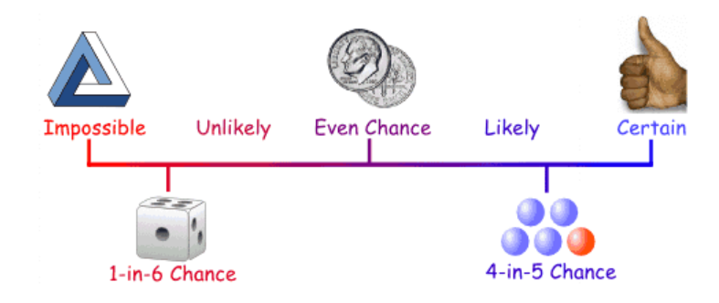
What is Probability and Statistics??
Probability is the is the chance that something will happen — how likely it is that some event will happen
Statistics as concerned with data science is a tool used to gain deeper and more fine grained insights into how exactly our data is structured and based on that structure how we can optimally apply other data science techniques to get even more information

Slide 19
Why Probability is important?
Uncertainty and randomness occur in many aspects of our daily life and having a good knowledge of probability helps us make sense of these uncertainties. Learning about probability helps us make informed judgments on what is likely to happen, based on a pattern of data collected previously or an estimate.
Data science often uses statistical inferences to predict or analyze trends from data.

Slide 20
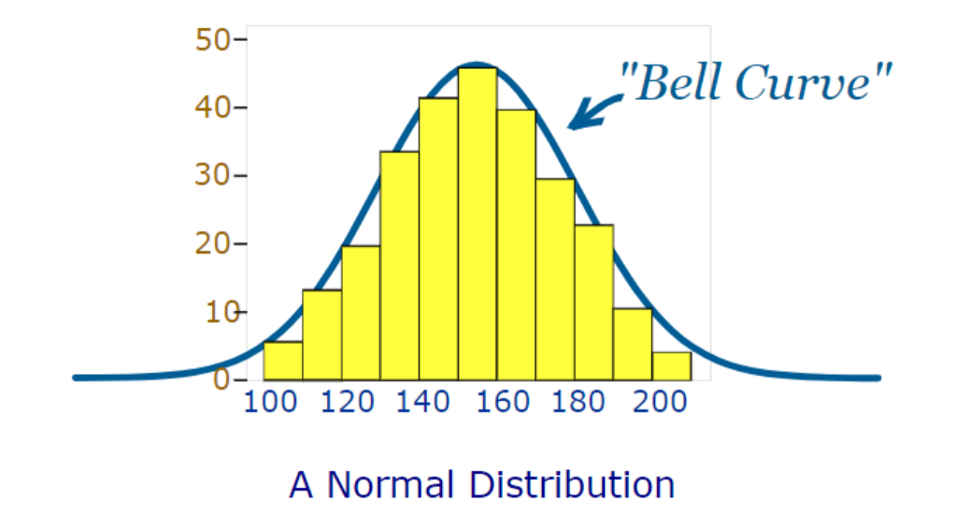
Some Terminologies in Probability
Binomial Probability refers to probabilities that only two possible situations such as either head or tail during a coin toss statistical inferences to predict or analyze trends from data.
The probability distribution for a random variable describes how the probabilities are distributed over the values of the random variable.
Normal distribution also known as the Gaussian distribution, is a probability distribution that is symmetric about the mean, showing that data near the mean are more frequent in occurrence than data far from the mean

Slide 21
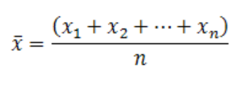
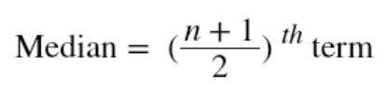
Important Terminologies in Statistics
Measures of Central Tendency
Mean:
Median:
Mode: most occurring data in the dataset

Slide 22
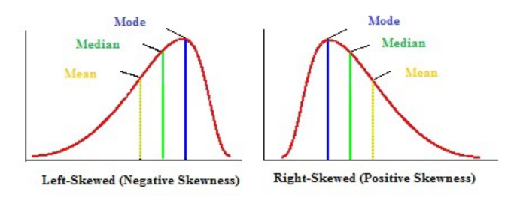
Important Terminologies in Statistics
Measures of Skewness
Skewness: Skewness is the asymmetry in a statistical distribution, in which the curve appears distorted or skewed towards to the left or to the right. There are two types of skewness, left-skewed and right-skewed

Slide 23

Important Terminologies in Statistics
Measures of Variability (Dispersion)
Range: The difference between the largest and the smallest value of a data
Variance: measures how far is the sum of squared distances from each point to the mean i.e the dispersion around the mean
Standard deviation: a square root of the variance.

Slide 24
For Further Knowledge…..
3blue1brown’s YouTube channel - https://www.youtube.com/channel/UCYO_jab_esuFRV4b17AJtAw/playlists
. Khan academy- https://www.khanacademy.org

Slide 25
References
https://towardsdatascience.com/linear-algebra-for-deep-learning-f21d7e7d7f23
https://towardsdatascience.com/probability-for-data-science-9770b26643d0
https://towardsdatascience.com/calculus-in-data-science-and-its-uses-3f3e1b5e5b35

